Slide 1

A programming approach to drug interaction
For the progrraming in life sience practical ;by Lukas Bowen , Alexander Leonidas & Wladimir Lefebure

Slide 2
Why are those interaction relevant nowadays ?
An aging population
Research and industry
change in drug consumption pattern

Slide 3
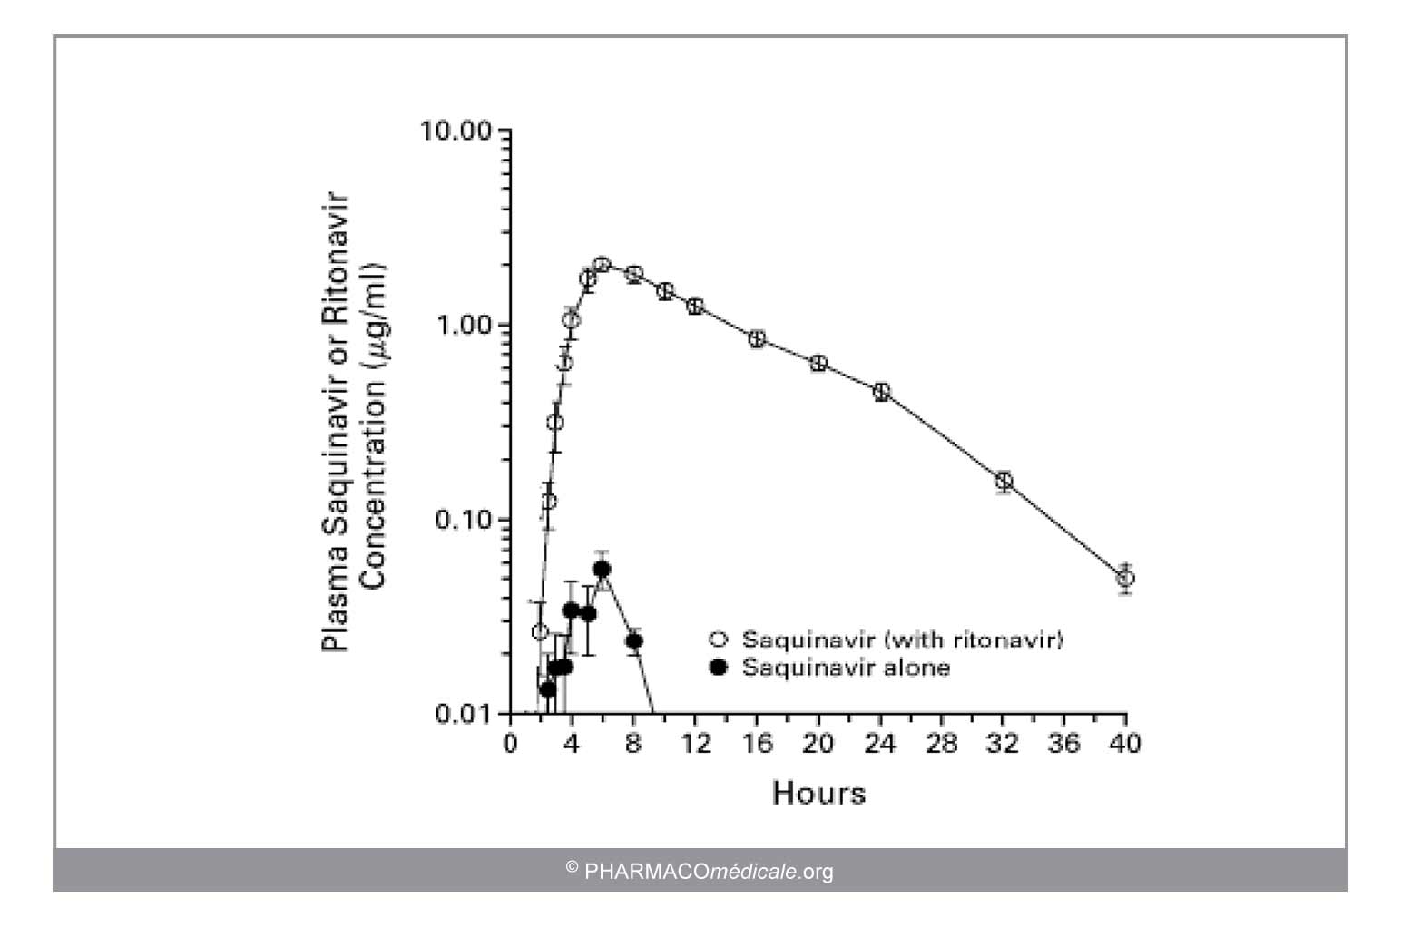
But not always negative …

Slide 4
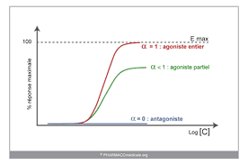
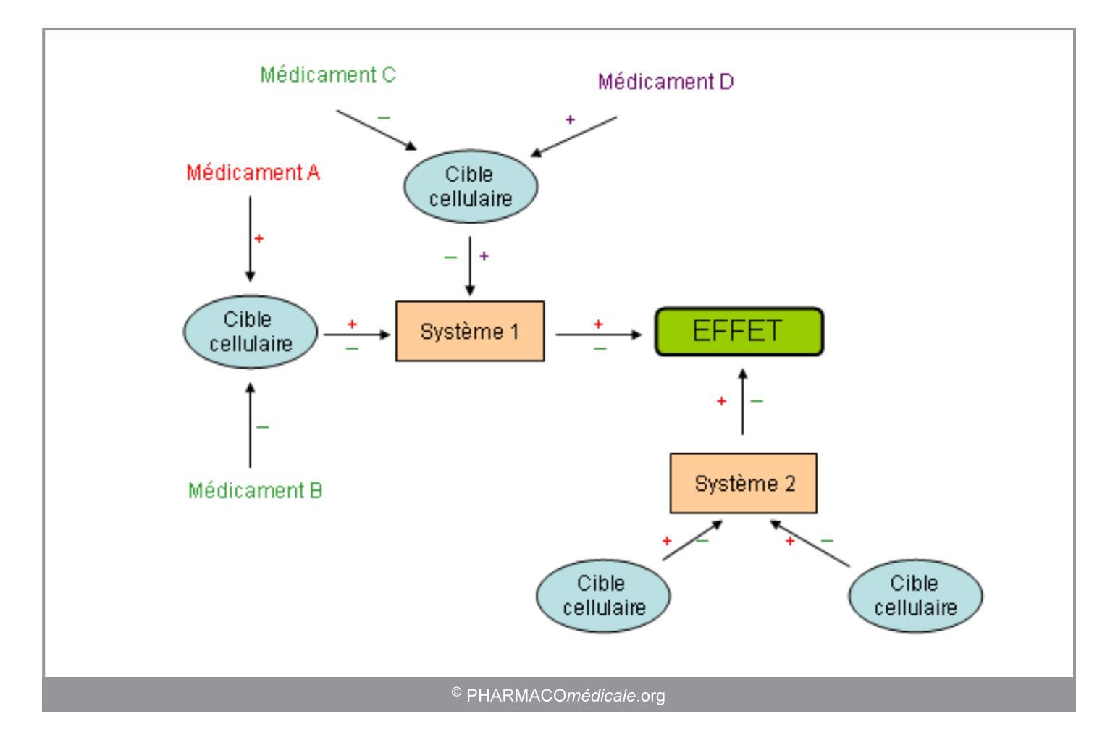
Pharmacocinetics VS pharmacodynamics
Biodisponibility distribution
Metabollisme
Clearence
Modulate effects
Inhibits/potentialisation
Exposure remain constant

Slide 5
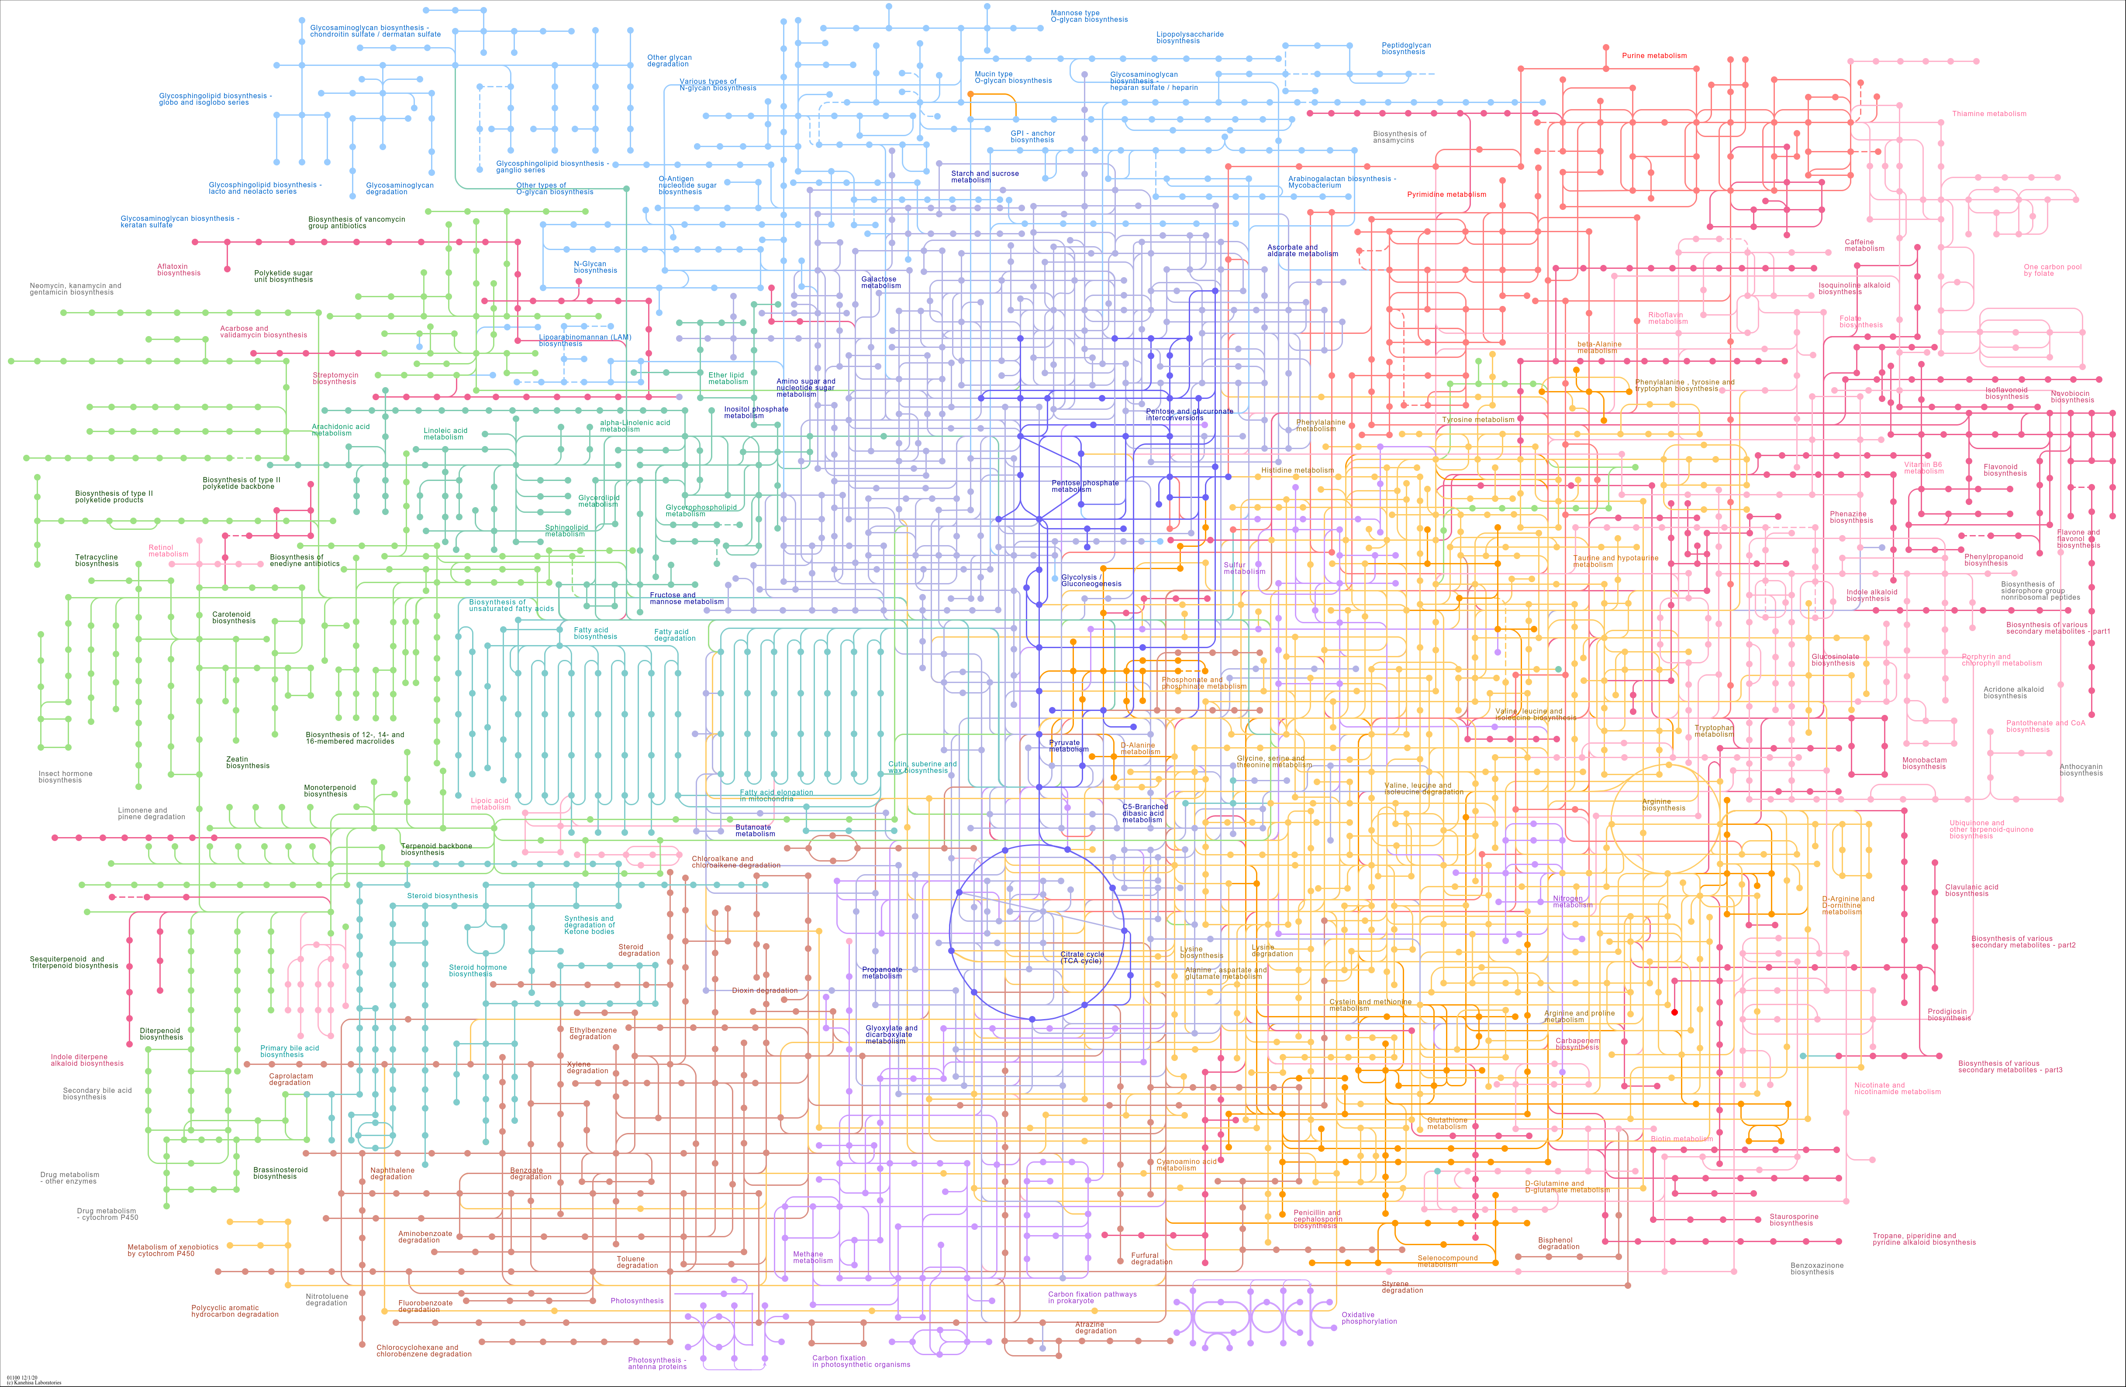
Dealing with potential interraction

Slide 6
A simple potuslate
« Two drugs that share at least a common pathway or system ,will most likely interact »L.A.W 2020

Slide 7
2 sparql entry point
wiki_data
Select drug used to treat ….
Bio2rdf
List the pathways in wich this KEGG ID is involved
Select a fixed drug ….
Retrieved KEGG iD of given drug

Slide 8
For each drug use to treat […]
Initial Pathway list
yes
link
no
No link
Are at least one pathways member of ?
If
Then

Slide 9
A live demonstration

Slide 10
Advantages and limitiations
Pro
con
-the simplicity
- the modulaity
A quick visual interpretation
Narrowing down data
A good prelimanary step
Dependent on the database structure
A top to bottom aprroach
An emphasis on pharmacodynamics
Presicion

Slide 12
Possible improverment
Implementing a graduation based on the number of common pathways
Automatic cross validation on allready known interraction data base
C vs D
Appoach through pharmacocinetics by specifing the structure

Slide 13
KEGG ID structures
Kyoto Encyclopedia of Genes and Genomes
For compounds : C or D and 5 Numbers
Pathways change depending if conisdered as a coupound or a drug

Slide 14
